Slide 1

An Information Site for Pharmacists
Nikkei Drug Information Online
Advertisement Menu
November 2014
Please review the following document for more information about requesting and placing advertisements.
http://adweb.nikkeibp.co.jp/adweb/wad/doc/bp_kitei.pdf
20141106

Slide 2
What is Nikkei Drug Information Online?
An Information Site for Pharmacists
http://di.nikkeibp.co.jp/
Nikkei Drug Information Online provides information that pharmacists will find useful in their work including original articles produced by the Nikkei Drug Information editorial team for pharmacies and pharmacists and drug-related topics selected from Nikkei Medical Online.
▶Site Data
Registered pharmacists: 80,293 (as of September 30, 2014)
* Based on the number of unique browsers.
◆As of September 2014 (data collected by Site Catalyst)
Contact information: med-ad@nikkeibp.co.jp AD Web http://adweb.nikkeibp.co.jp/adweb/wad/
Notes:
2

Slide 3
Nikkei Drug Information Online
Advertisement Menu

Slide 4
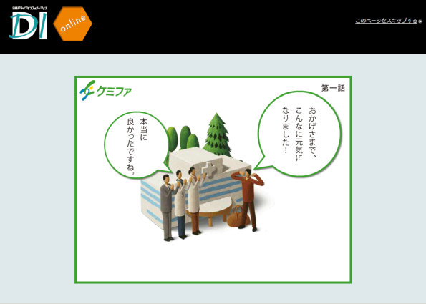
Welcome Banner

Slide 5
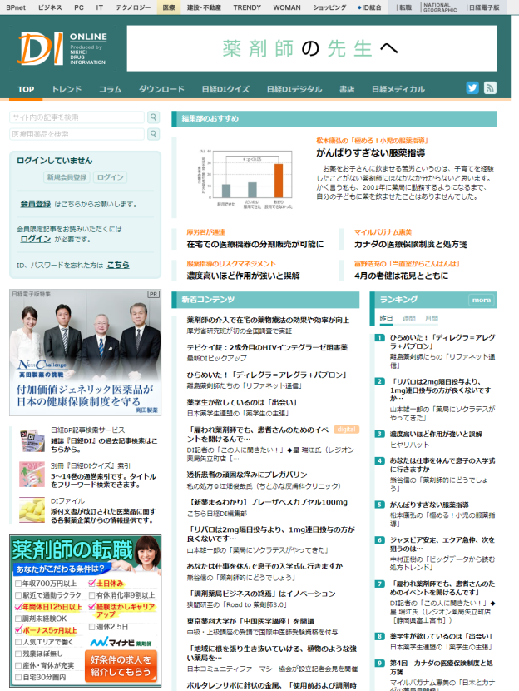
First Rectangle

Slide 6
Second Rectangle

Slide 7
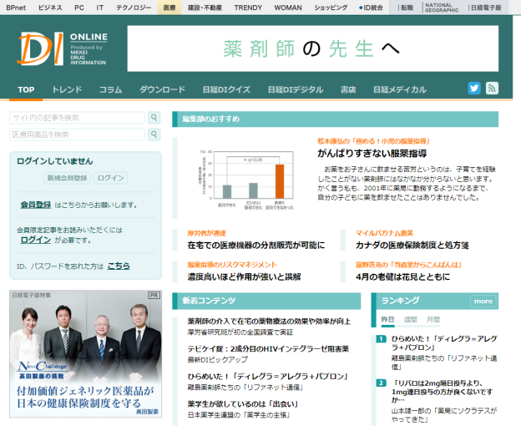
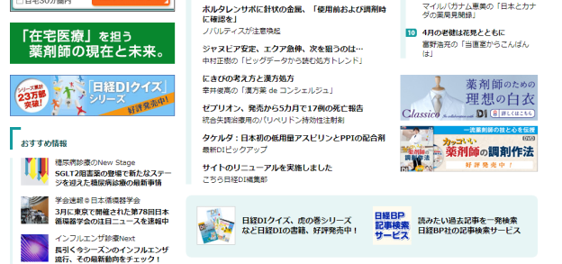
Visual Box

Slide 8
Leaderboard

Slide 9
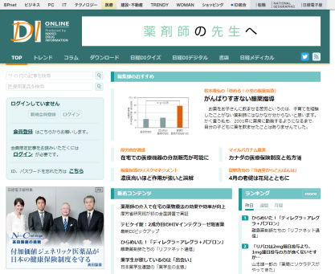
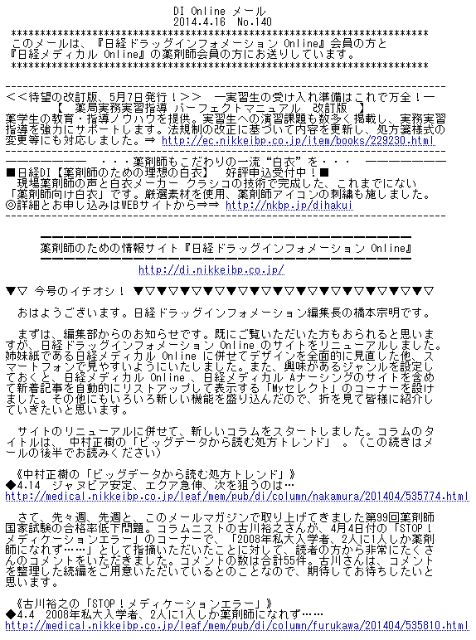
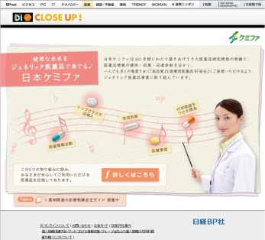
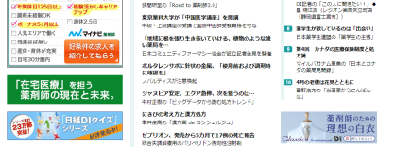
DI Online CLOSE UP！
Tie-Up Site Standard Package
More detailed information can be provided through an advertorial on the Website.
Home Page
DI Online Email
Tie-Up Site ★
2
To Tie-Up Site
1
1
Rate ¥900,000 (gross)
Notes:
9

Slide 10
DI Online Email Header
Notes:
10

Slide 11
DI Online Email Header Double
Notes:
11

